Slide 1
Target Plate Assembly Pictures
Normal Target Plates & Transponder Target Plate w/battery
Color Sheets

Slide 2
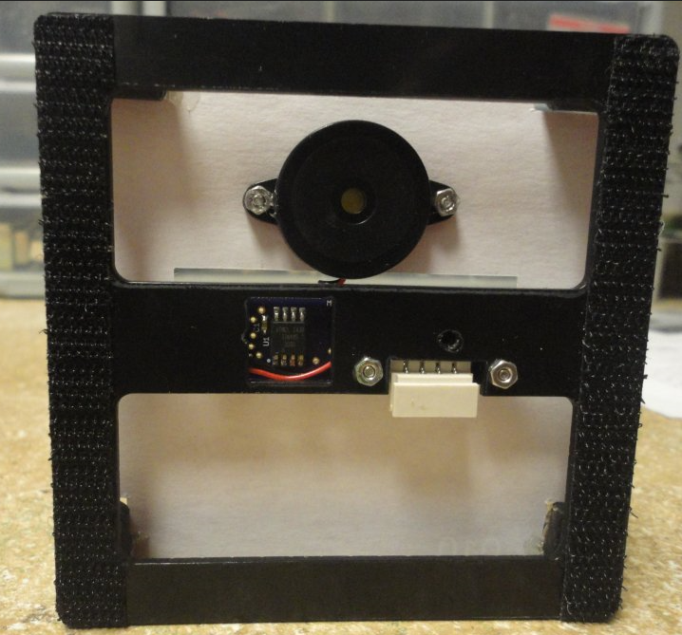
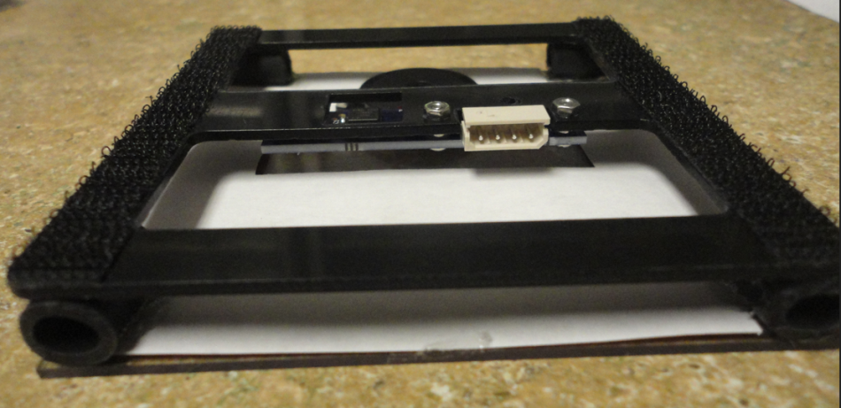
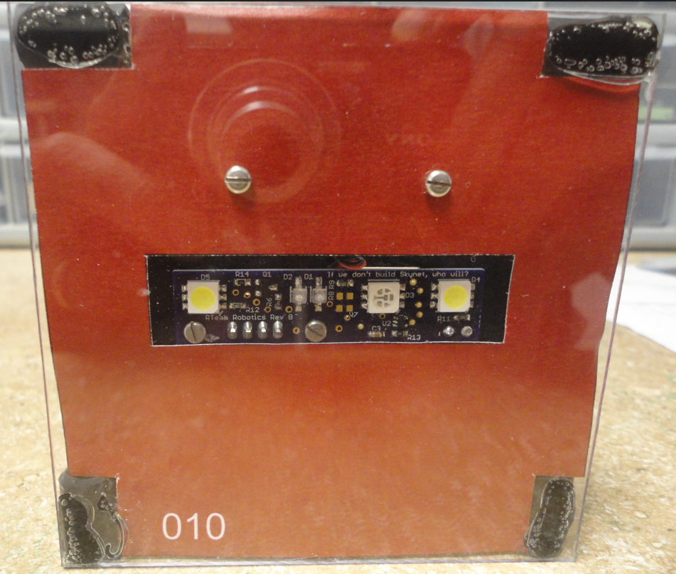
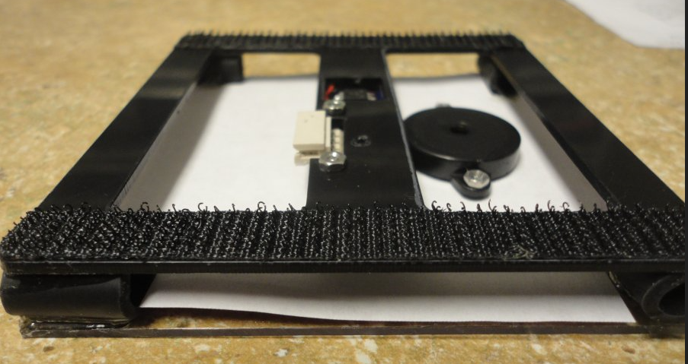

Slide 3
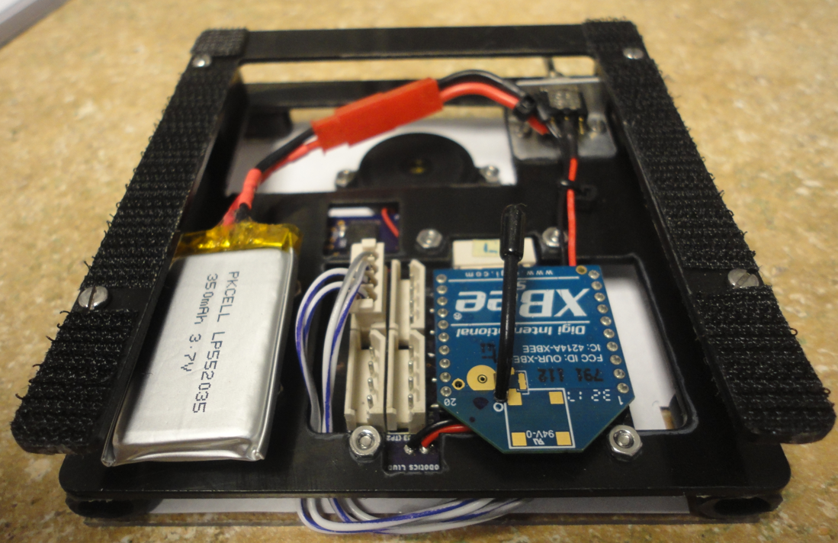
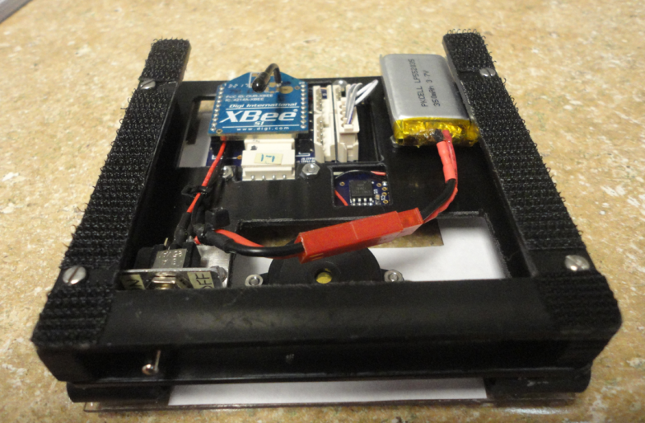
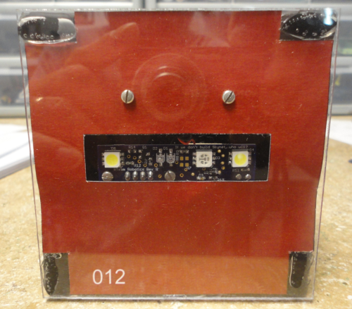
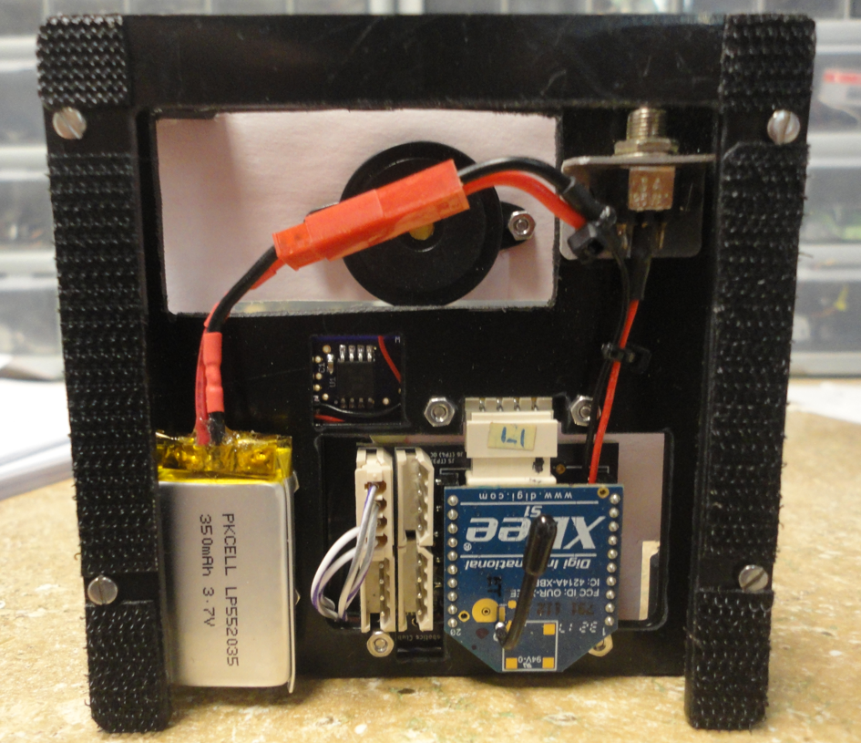
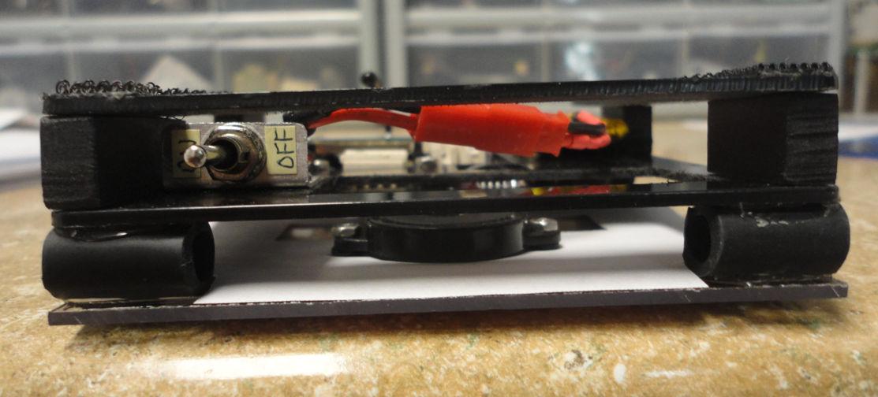

Slide 4
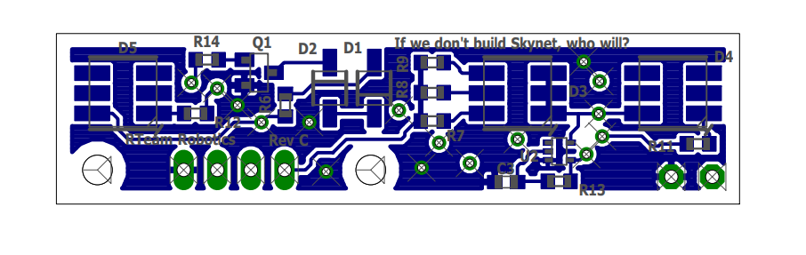
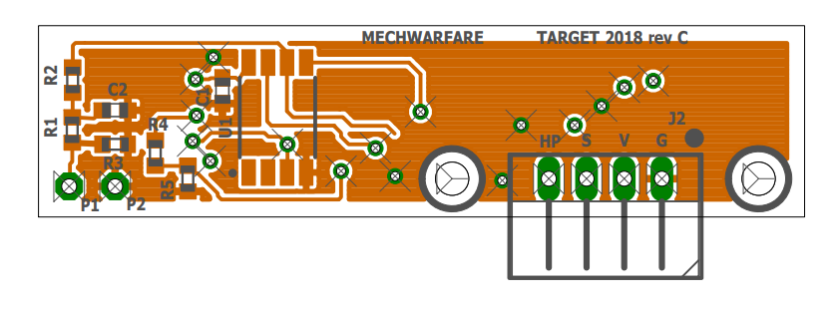

Slide 5
Target Plate backside color
3.5”x 3.5”
0.6”x 0.32”
2.19”x 0.56”
001
3.5”x 1.75”
2.19”x 0.56”
0.6”x 0.32”
058
004

Slide 6
Target Plate backside color
054
055
056
057
004

Slide 7
Target Plate backside color
050
051
052
053
004

Slide 8
Target Plate backside color
058
058
058
058

Slide 9
Target Plate backside color
058
059
060
061

